Slide 1


MapGAN: GENERATING ELECTRONIC MAPS FROM SATELLITE IMAGES
PRESENTED BY:
ANUJ TIMSINA
PRAJWAL CHHETRI
SACHI KAMAT
SANDIP THAPA

Slide 2
Compared to satellite images, electronic maps have a better advantage since they have higher accuracy and absence of distortions as well as automatic routing and control over deviations from the selected course.
WHY DO WE NEED MAPS?

Slide 3
To generate a standard layer of maps from satellite images using conditional-GAN.
CONCEPT

Slide 4

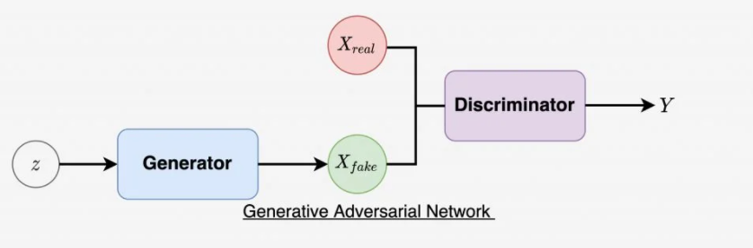
GAN
GANs are a clever way of training a generative model by framing the problem as a supervised learning problem with two sub-models: the generator model that we train to generate new examples, and the discriminator model that tries to classify examples as either real (from the domain) or fake (generated).

Slide 5
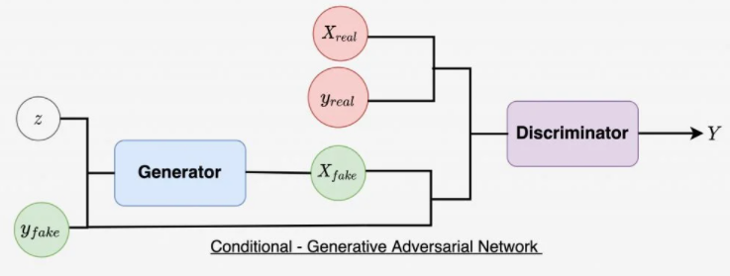
cGAN
In cGAN, a conditional setting is applied, meaning that both the generator and discriminator are conditioned on some sort of auxiliary information from other modalities. As a result, the ideal model can learn multi-modal mapping from inputs to outputs by being fed with different contextual information.

Slide 6
The Pix2Pix model is a type of conditional GAN, or cGAN, where the generation of the output image is conditional on an input, in this case, a source image. The discriminator is provided both with a source image and the target image and must determine whether the target is a plausible transformation of the source image.
Pix2Pix GAN

Slide 7
We have used two datasets to train this model. One is the so-called “maps” dataset used in the Pix2Pix paper and the other one is self-prepared by us using Google maps and CV2 script.
DATASETS

Slide 8
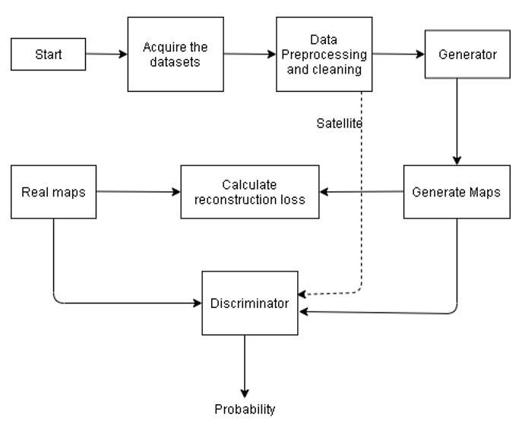
Satellite
BLOCK
DIAGRAM

Slide 9
FUNCTIONAL REQUIREMENTS
Users can acquire maps of any place having satellite images.
The system can generate desired maps for every satellite image.

Slide 10
The system is quite dependable in terms of the results it displays, i.e. there is no bogus data.
Because it can be used on big datasets, the system is scalable.
Our system is versatile in that it may be applied to a variety of scenarios. It isn't restricted to satellite photos as an input.
NON-FUNCTIONAL REQUIREMENTS

Slide 11

METHODOLOGY

Slide 12
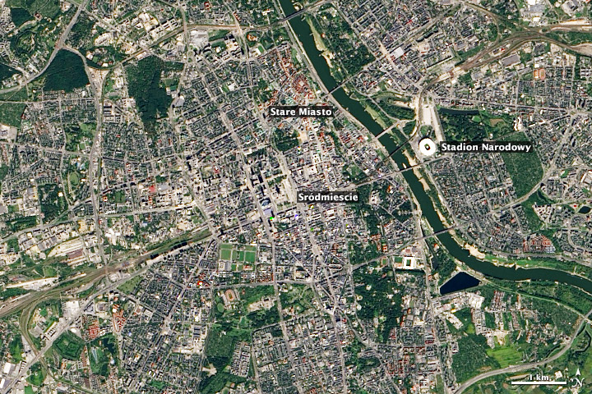
Takes a satellite image as an input

Slide 13
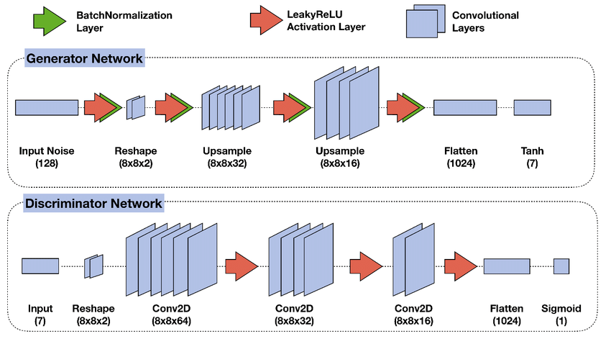
Generator and Discriminator are two models in the network.

Slide 14
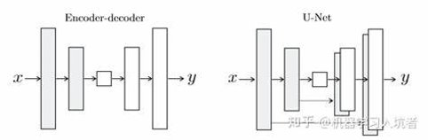
U-Net Generator
The generator takes in the image to be translated and compresses it into a low dimensional, bottleneck, vector representation.
The information from earlier layers are integrated into later layers through skip connections.
Skip connections do not require any resizing, projections, etc. since the spatial resolution layers being connected already match each other.

Slide 15
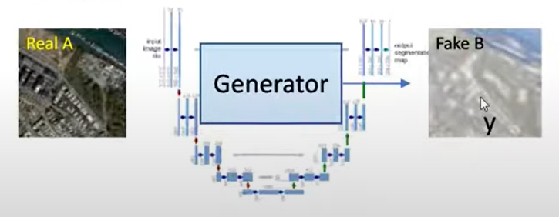
Generator generates fake target image using real image input.

Slide 16
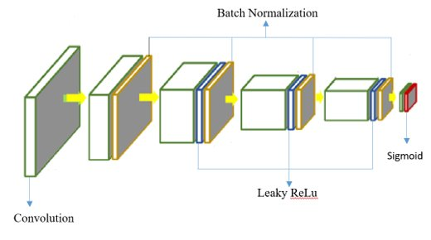
PatchGAN Discriminator
PatchGAN discriminator determines whether an image is real or fake by using local patches of the size.
It takes two input the real image(x) and fake image G(x).
Consists of five downsampling convolutional-BatchNormLeaky layers

Slide 17
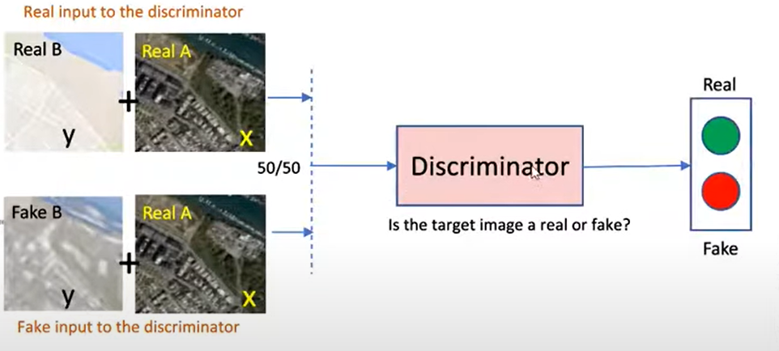
Discriminator is fed with pairs of input image and target image as inputs and outputs whether the image is real or fake.

Slide 18
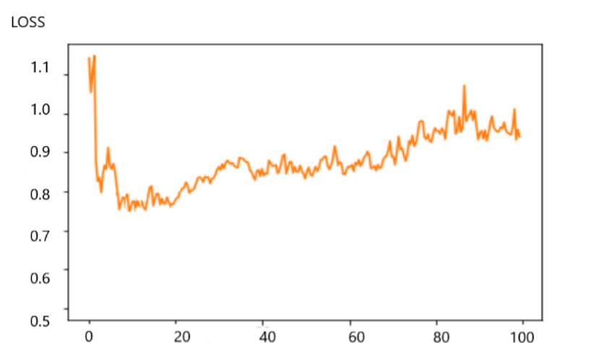
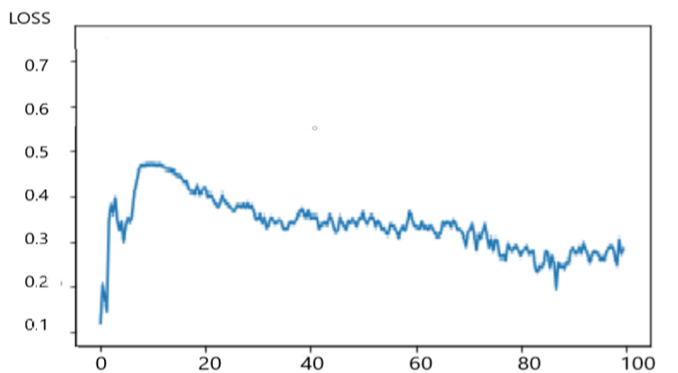
LOSS FUNCTION
Discriminator Loss: max_{(D)} E_{x~P(x)} [log(D(x))]+ E_{z~Pz(z)} [log(1-D(G(z)))]
Generator Loss: min_{(G)} E_{x~P(x)} [log(D(x))]+ E_{z~Pz(z)} log(1-D(G(z)))]
Reconstruction Loss: ||M_{fake}-M_{real}||₂
Fig.: Generator and Discriminator Loss

Slide 19
OPTIMIZER
Optimization is carried out to generator and discriminator loss. We have used Adam optimizer.

Slide 20
The limitations of our project are:
The project doesn’t have any 3D implementations.
The project is incapable of generating maps of wider range of areas yet.
LIMITATIONS

Slide 21
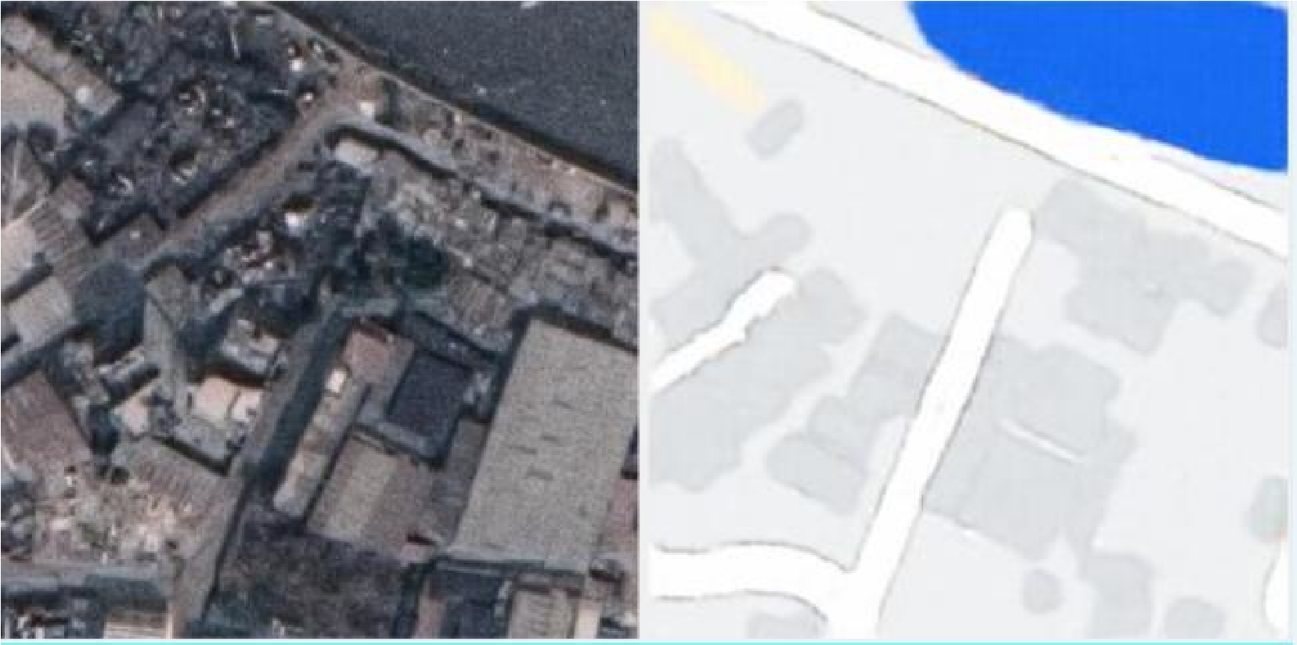
RESULTS FROM OUR MODEL
Fig. : Maps containing roads, buildings and lake

Slide 22
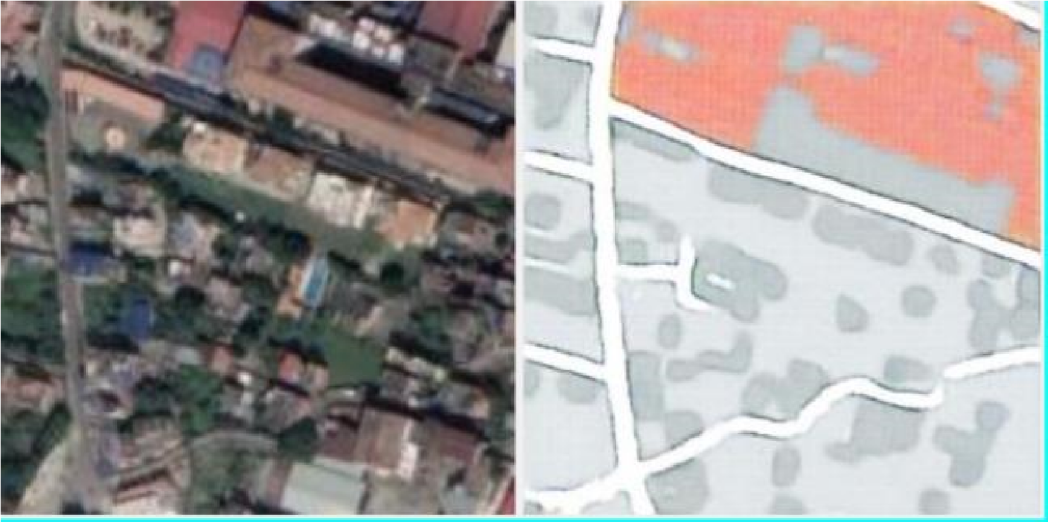
Fig. : Maps including roads and buildings

Slide 23
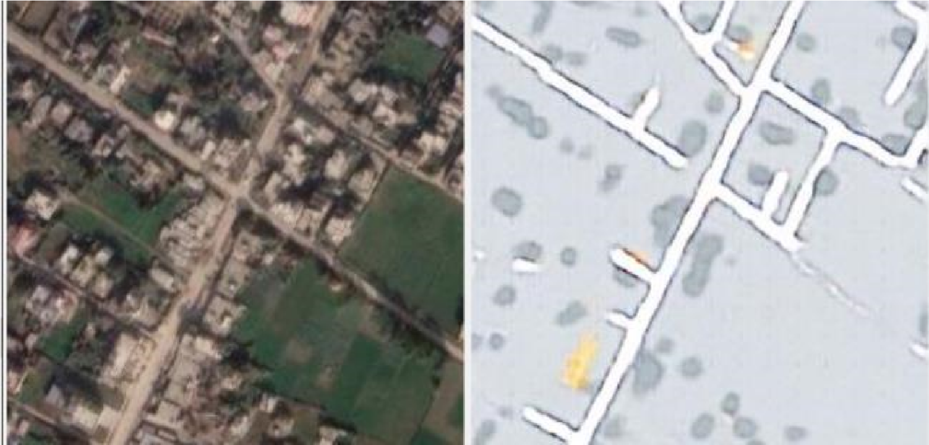
Fig. : Maps including roads, buildings and open lands

Slide 24
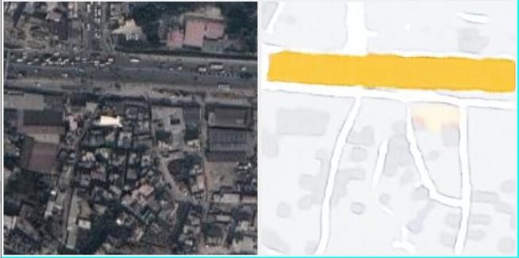
Fig. : Maps including roads, buildings and highways

Slide 25
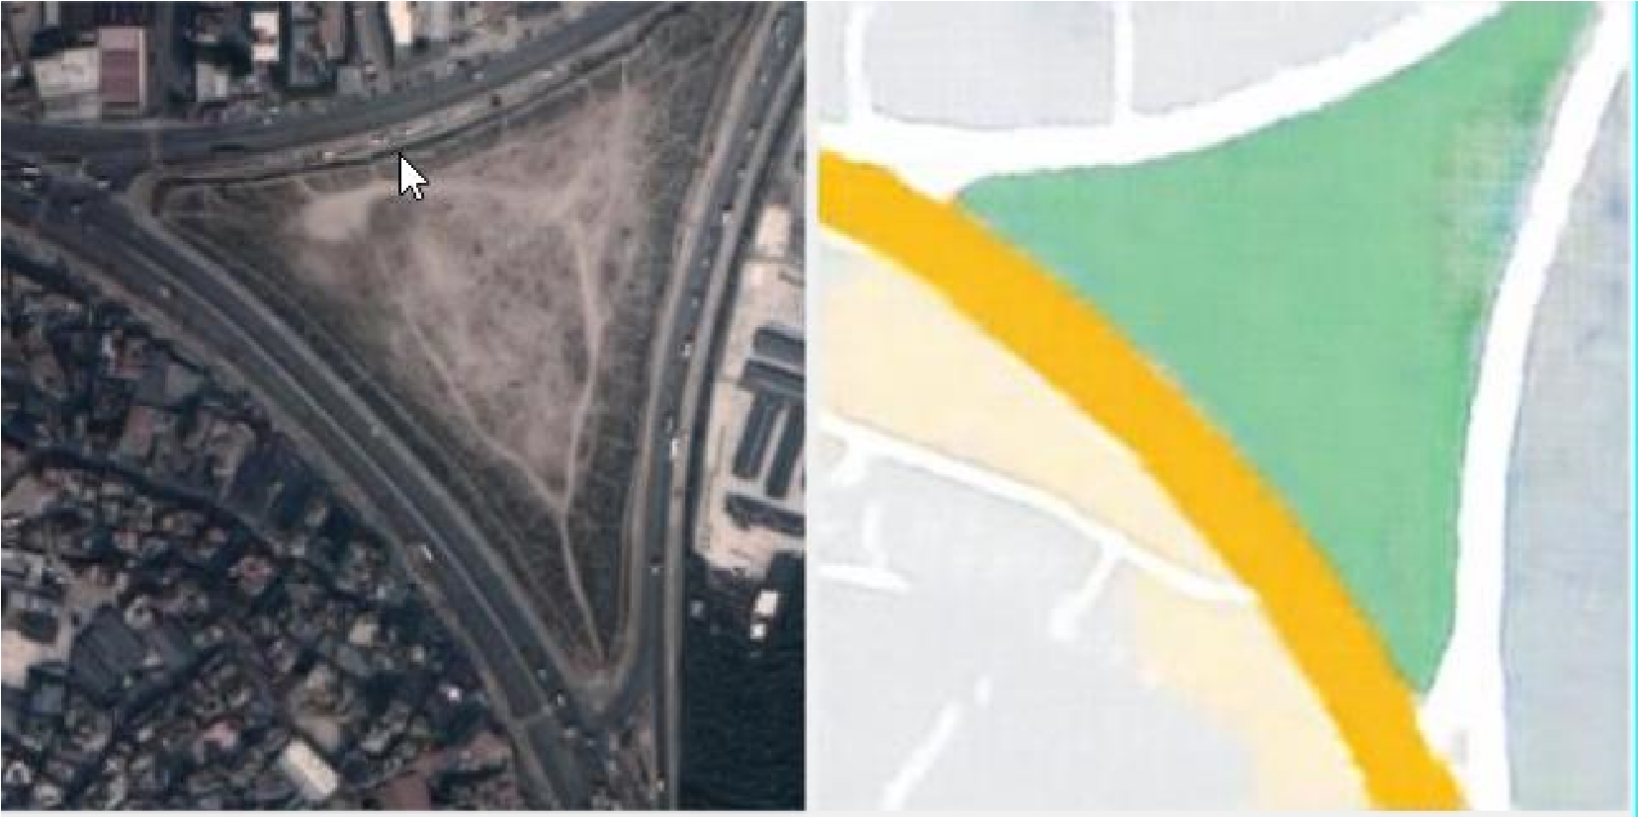
Fig. : Maps including roads, highway and open lands

Slide 26


